Slide 1
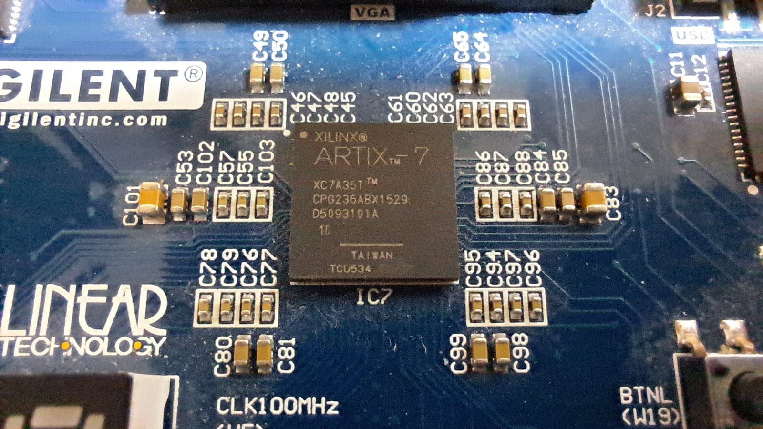
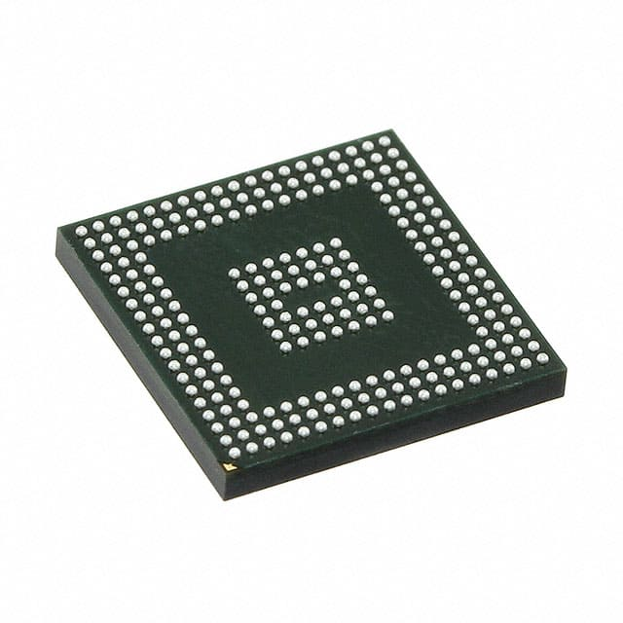

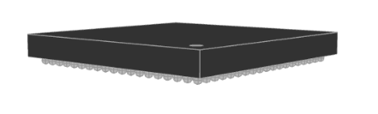


Implementing Anubis Algorithm on Xilinix FPGA Hardware
https://media.digikey.com/Photos/Xilinx%20Photos/236-CSBGA.jpg
Participants: Yosef Berger , Aharon Gilo
Team Number: xohw22-025
Supervisor: Mr. Uri Stroh
https://app.ultralibrarian.com/details/ba760ae1-3fab-11eb-9033-0a34d6323d74/Xilinx-Inc/XC7A35T-1CPG236I?open=backlink

Slide 2
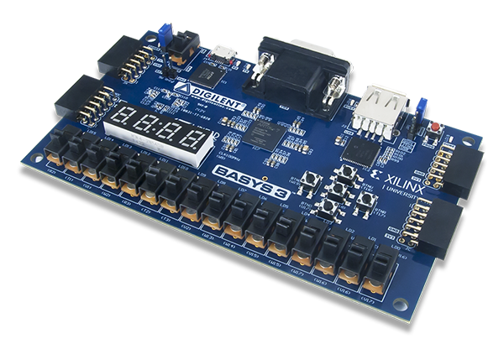
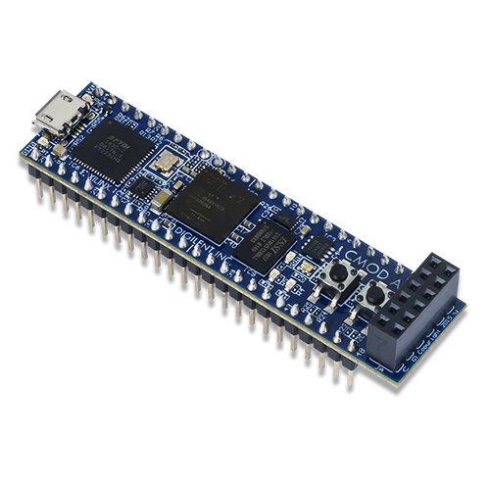
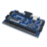
Table of contents
Executive Summary
Background
Why do we need Anubis Algorithm?
How does the Algorithm work?
What are the advantages of usage?
Design
Communication
Design Simulation
Synthesis
Place and Route
Results
Methodology
Structure
Electrical Results
Functionality
Discussion
Further Directions

Slide 3
Our Challenges
Design of Anubis block cipher CORE with Verilog HDL
For Encryption of a 128 bits of Data , Anubis Algorithm needs at least 384 bits,
Finding a unique and simple way to implement the 384 bits needed to the Anubis algorithm on an artix-7 FPGA!
Algorithm Implementation on Xilinix Artix-7 , with the use of Digilent’s BASYS3 & CMOD-7 boards ,Simulation tools and Vivado
Executive Summary

Slide 4




https://discoveringegypt.com/ancient-egyptian-gods-and-goddesses/
Taken: 22/11/2021 8:55 AM
Anubis
Ἄνουβις is a Greek rendering of this god's Egyptian name: inpw / ⲁⲛⲟⲩⲡ Anoup - Protector of the Dead, was also known as “Master of Secrets”. Anubis is shown as a jackal-headed man, or as a jackal.
He was closely associated with mummification and as protector of the dead. It was Anubis who conducted the deceased to the hall of judgment.
Background 1

Slide 5
Why do we need Anubis Algorithm?
Anubis is a block cipher designed by Vincent Rijmen and Paulo S. L. M. Barreto as an entrant in the NESSIE project, a former research program initiated by the European Commission in 2000 for the identification of new cryptographic algorithms. As a replace of former DES (Data Encryption Standard). Although the cipher has not been included in the final NESSIE portfolio, its design is considered very strong, and no attacks have been found by 2004 after the project had been concluded.[1] The cipher is not patented and has been released by the designers for free public use.[2]
[1] B. Preneel; A. Biryukov; C. De Cannière; S. B. Örs; E. Oswald; B. van Rompay; L. Granboulan; E. Dottax; G. Martinet; S. Murphy; A. Dent; R. Shipsey; C. Swart; J. White; M. Dichtl; S. Pyka; M. Schafheutle; P. Serf; E. Biham; E. Barkan; Y. Braziler; O. Dunkelman; V. Furman; D. Kenigsberg; J. Stolin; J.-J. Quisquater; M. Ciet; F. Sica; H. Raddum; L. Knudsen & M. Parker (April 19, 2004). New European Schemes for Signatures, Integrity, and Encryption (PDF) (Final report of European project number IST-1999-12324).
[2] Barreto & Rijmen 2000, accompanied Intellectual Property Statement
Background 2

Slide 6
How does the Algorithm work?
For Encryption of a 128 bits block of Data , Anubis Algorithm needs at least 384 bits:
1. Input : 128 bits of Plaintext Data
2. Input: 128 bits of given Key Data (or 192/…/320 bits)
3. Anubis Core – Block cipher “engine”
4. Output: 128 bits of Cyphertext Data
And vice versa for decryption .
Background 3

Slide 7
What are the advantages of usage?
Secured - the block cipher prevents usage of leaked data, only key holder, can decrypt the messages.
Simple- with the implemented Anubis core, 128 bits of data are easily transferred to an Encrypted block by the designed core.
Background 4

Slide 8
Details on BASYS 3™ – Fpga Board
On board is Xilinix Artix™ 7 XC7A35T™ FPGA with CPG236 package
The FPGA has 106 available I/O’s : (Shown in the next slides)
With the given configuration there are less available pins; the board implements different sources, such as: push buttons, slide switches, Pmod Connectors, and more…
We Have an I/O constraint!
Therefore, we need to find a unique way to implement the 384 bits needed to the Anubis algorithm.
Design 1 –Artix 7

Slide 9
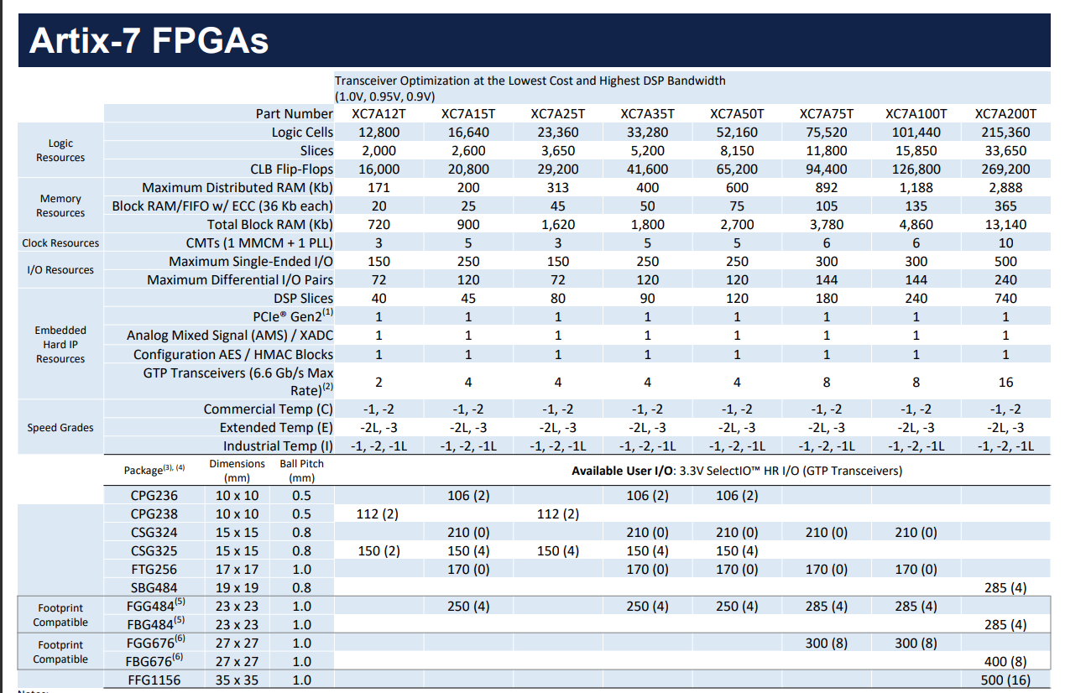
https://www.xilinx.com/content/dam/xilinx/support/documents/selection-guides/7-series-product-selection-guide.pdf
Design 1 - Artix 7

Slide 10
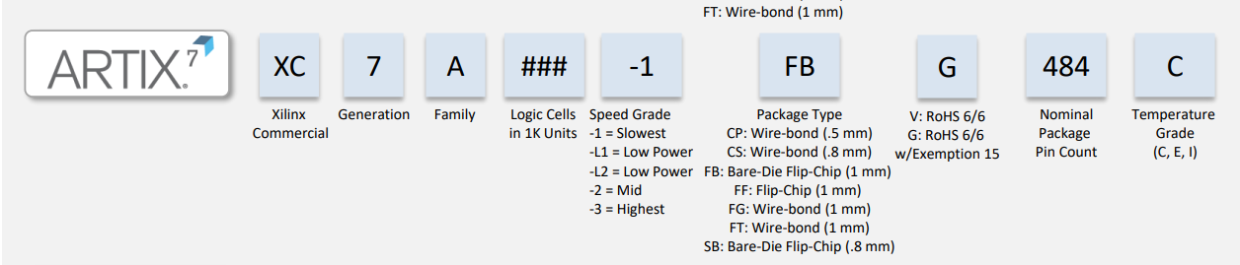
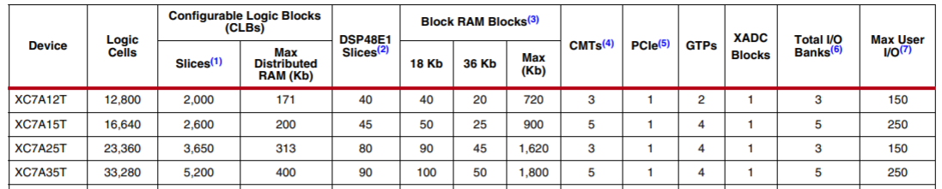
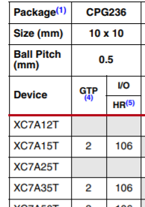
Xilinix® Artix™ XC7A35T™ -1 CPG236
Design 1 - Artix 7

Slide 11
Our Solution
Block Cypher Algorithm:
We will gather up the required data bits as a package and will send them serially bit by bit to each of the FPGA boards.
The received data will be analyzed before process and will be confirmed to pass the Encryption/Decryption process.(control signals)
The Data and Key will be transferred through a 6-bits communication channel
To control the system, we will need to decide on a communication protocol.
Our Goal - The implementation must be simple, and user friendly.
Design 2 – communication 1

Slide 12
Our Solution
CMOD A7 – a Xilinix Artix 7 FPGA board, our remote device
Will gather the information from the user plaintext Data/ cyphertext Data
The information will be sent to the destination using PMOD connector,
The destination : Basys 3 FPGA Boards, which has a IO source which interfaces with PMOD connector. Holds the Anubis algorithm Encryption / Decryption.
Design 2 – communication 2

Slide 13
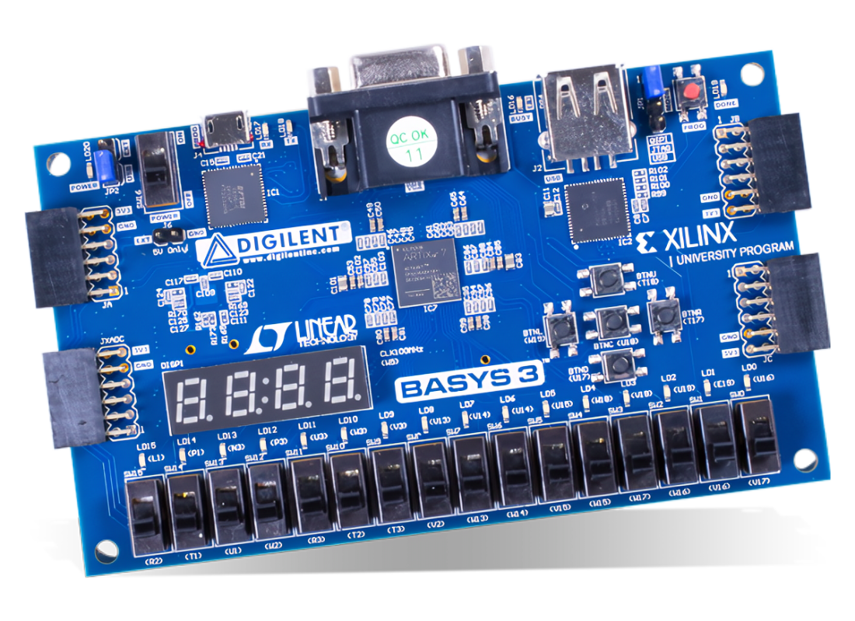
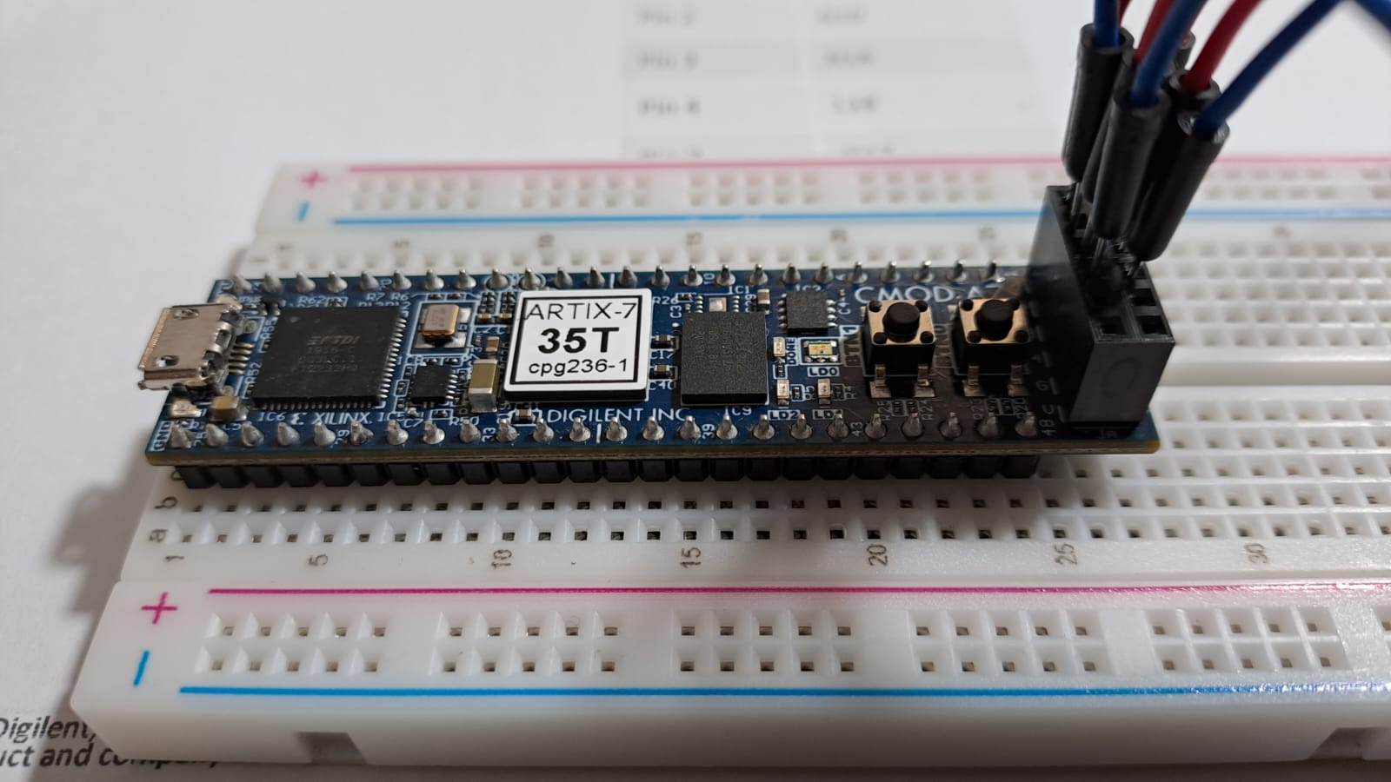
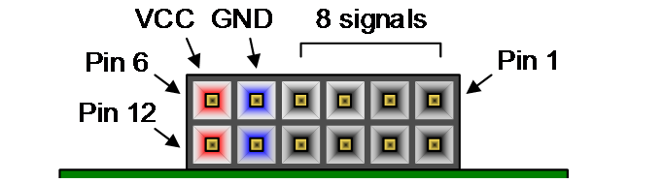
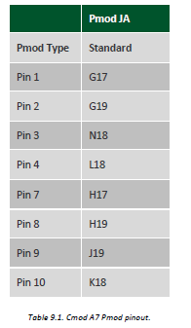
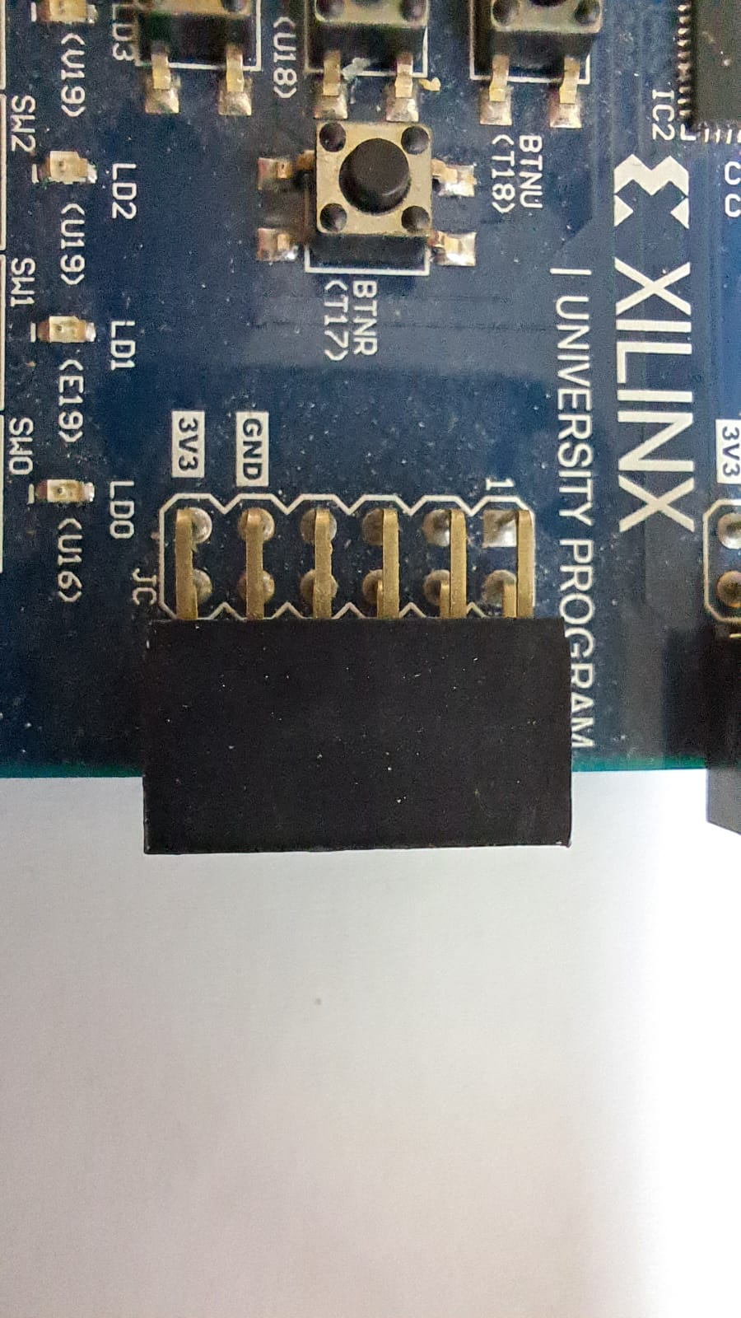
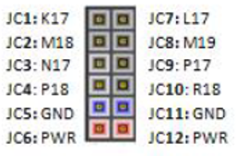
Digilent® INC. BASYS 3™
Artix™-7 XC7A35T™ cpg236-1
Digilent® INC. CMOD A7
Artix™-7 XC7A35T™ cpg236-1
Pmod
Pmod
Pmod
Pmod
Pmod
Pin 1
Pin 7
Pin 6
Pin 12
Pin 1
Pin 6
Design 3 – Pmod Connectors

Slide 14
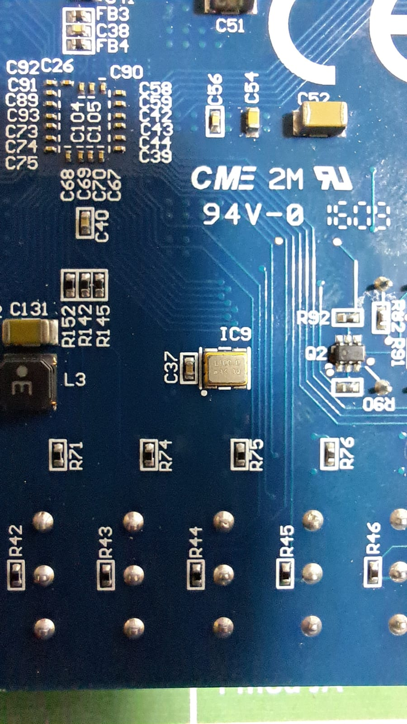
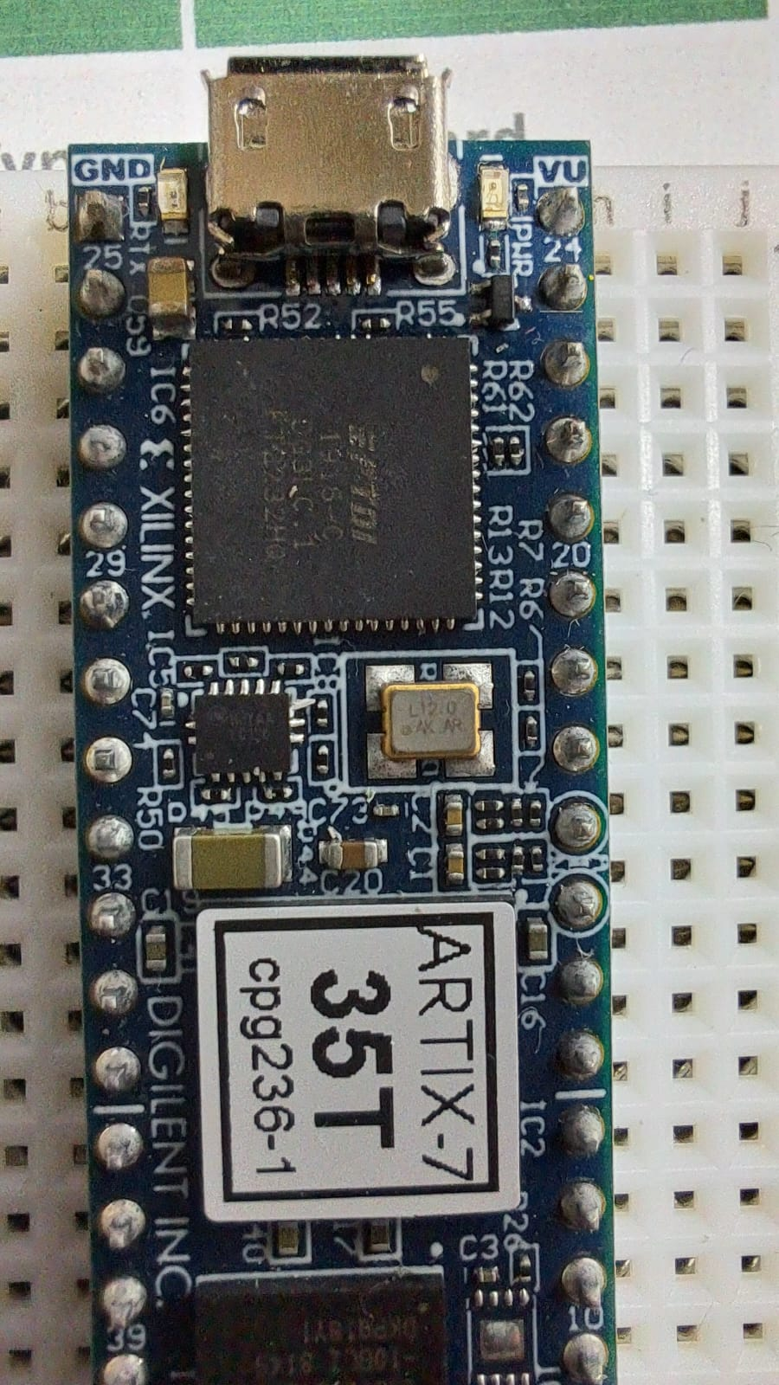
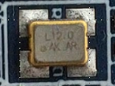
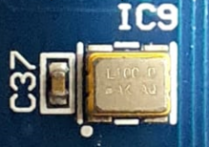
CMOD A7 onboard clock
BASYS 3 onboard clock
Oscillators/Clocks
The FPGA Basys3 board components used during this project, are Faster than the Cmod A7.
The clock of the Basys3 is 100MHz.
In contrast, the Cmod A7's clock is only 12MHz.
In order to properly communicate between these components Without losing information, a communication protocol is needed to ensure that the information is sent correctly.
The Basys 3 board includes a single 100 MHz oscillator connected to pin W5 (W5 is a MRCC input on bank 34).
The Cmod A7 board includes a single 12 MHz clock input connected to pin L17 (L17 is a MRCC input on bank 14).
Design 4 – Difference in communications

Slide 15
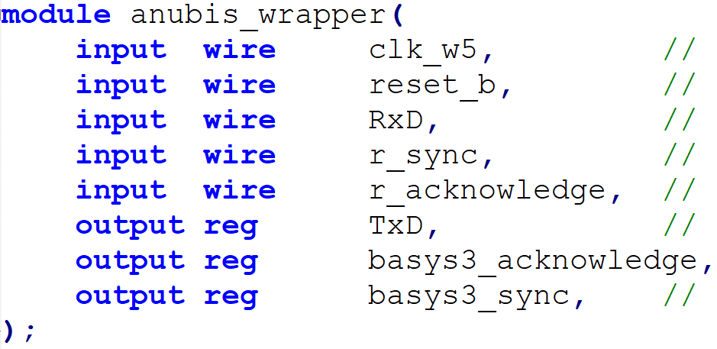
Pin 1
Signal | Pmod JC [artix-7 pin]
RxD | JC1: [K17] (Digital data)
TxD | JC7: [L17]
r_sync | JC2: [M18]
r_acknowledge | JC8: [M19]
basys3_sync | JC3: [N17]
basys3_acknowledge | JC9: [P17]
 | JC4: [P18]
 | JC10: [R18]
BASYS 3 Pmod
JC Connector
Design 5 – .xdc signal constraints

Slide 16
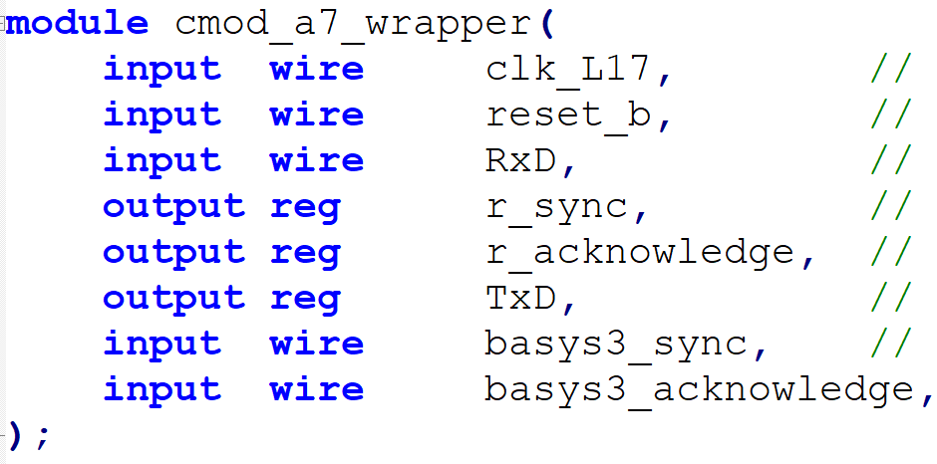
Pin 1
Pin 7
Pin 6
Pin 12
Signal | Pmod JA [artix-7 pin]
RxD | JA1: [G17]
TxD | JA7: [H17]
r_sync | JA2: [G19]
r_acknowledge | JA8: [H19]
basys3_sync | JA3: [N18]
basys3_acknowledge | JA9: [P19]
 | JA4: [L18]
 | JA10: [K18]
CMOD A7 Pmod
JA Connector
Design 5 - .xdc signal constraints

Slide 17
From Cmod A7 to Basys3
From Basys 3 to Cmod A7
Communication protocol between boards
Cmod A7 prepares data to be sent and send a Sync request to Basys3
Basys 3 prepares data to be sent and send a Sync request to Cmod A7
No
No
Does Basys3 is ready to receive new Data?
Does Cmod is ready to receive new Data?
Basys 3 – Anubis Encryption & Decryption Core “engine”
Yes
Yes
SYNC / Ack.
RxD / TxD
SYNC / Ack.
Basys3 sends Acknowledge to Cmod
Cmod A7 sends Acknowledge to Basys 3
Cmod A7 – Remote device that requests Anubis Encryption / Decryption
Basys3 receives the data from Cmod and stores in the relevant register (data_in,key_in)
Cmod A7 receives the data from Basys 3 and stores in the relevant register (data_out)
No
Did we send all the required data?
No
Did we send all the required data?
Yes
Yes
Design 6 – Com. Protocol
End
End

Slide 18
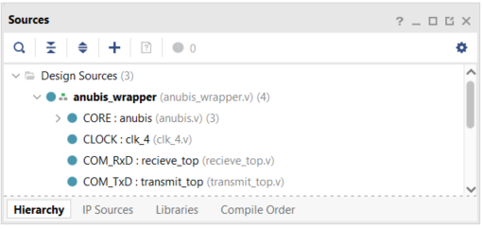
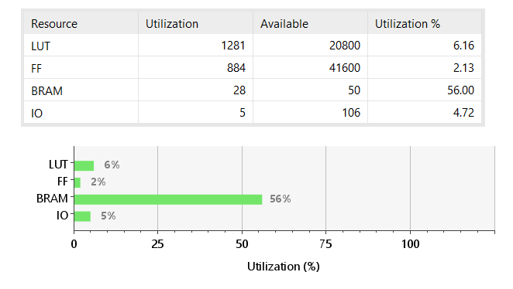
Synthesis – Vivado
Design 7 – Synthesis

Slide 19
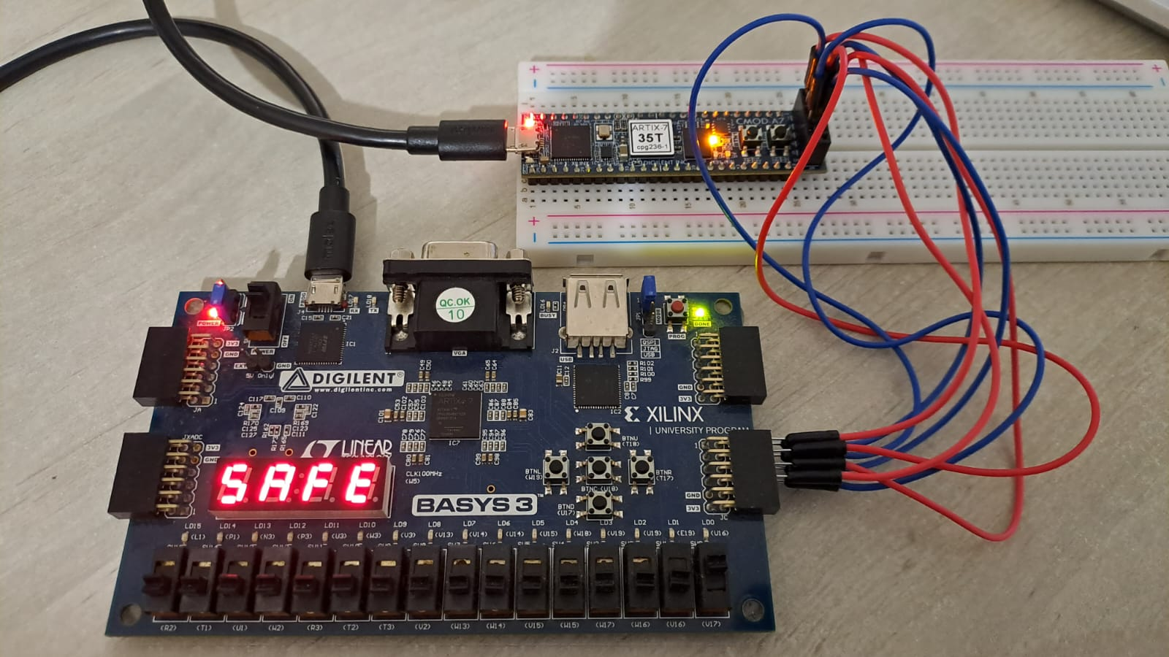

Slide 20
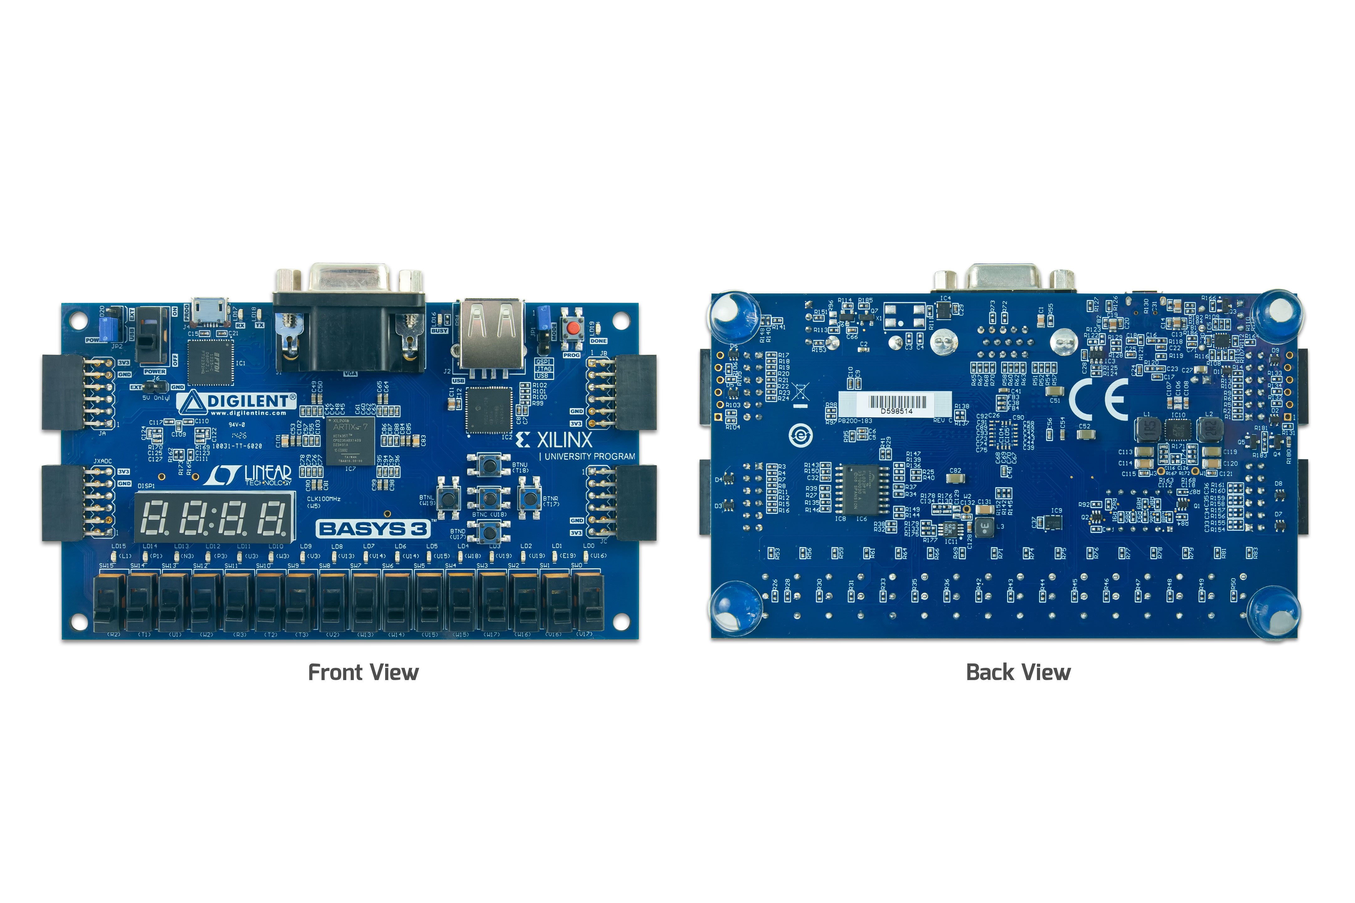
DIGILENT: BASYS 3 Xilinix Artix 7
https://digilent.com/reference/_media/basys3-frontbackviews.jpg
Appendix A1

Slide 21
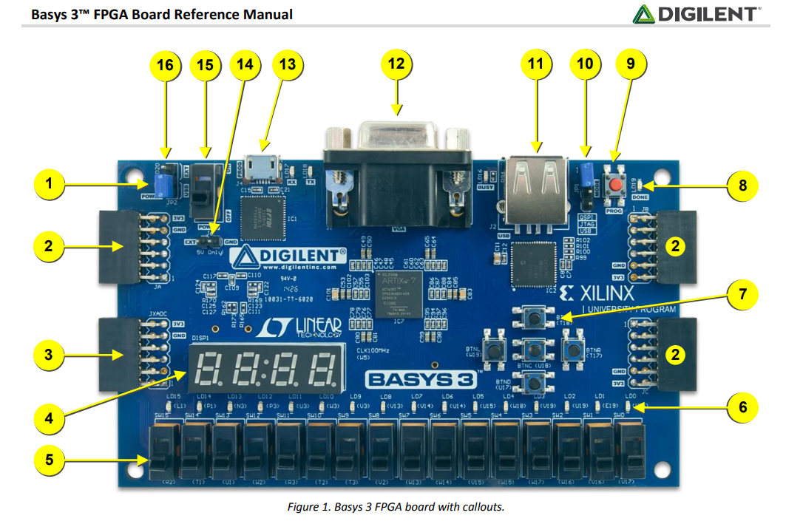
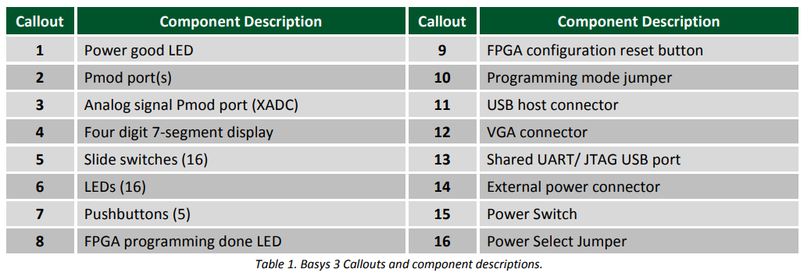
Appendix A2

Slide 22
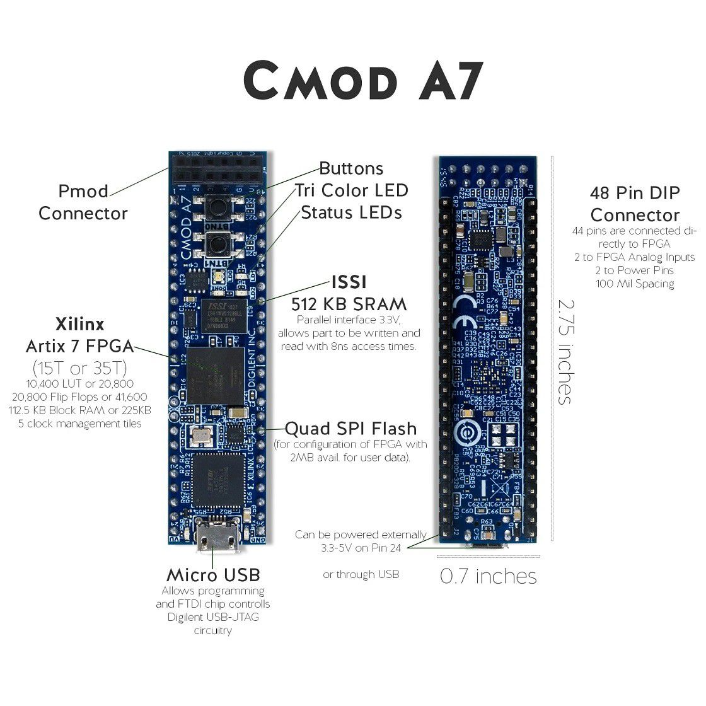
DIGILENT CMOD A7: Breadboardable Artix-7 FPGA Module
The Digilent Cmod A7 is a small, breadboard friendly 48-pin DIP form factor board built around a Xilinx Artix-7 FPGA. The board also includes a USB-JTAG programming circuit, USB-UART bridge, clock source, Pmod host connector, SRAM, Quad-SPI Flash, and basic I/O devices. These components make it a formidable, albeit compact, platform for digital logic circuits and MicroBlaze embedded soft-core processor designs using Xilinx's development software, Vivado. There are 44 Digital FPGA I/O signals and two FPGA Analog inputs that are routed to 100-mil-spaced through-hole pins so that you can integrate your programmable logic design directly into a solderless breadboard circuit. At just 0.7” by 2.75”, it can also be loaded in a standard socket and used in embedded systems.
https://static.cytron.io/image/cache/catalog/products/CMOD-A7/CMOD_A7_4-1120x1120.jpg
Appendix A3

Slide 23
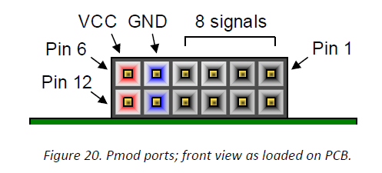
Pmod Ports
The Pmod ports are arranged in a 2x6 right-angle, and are 100-mil female connectors that mate with standard 2x6 pin headers. Each 12-pin Pmod port provides two 3.3V VCC signals (pins 6 and 12), two Ground signals (pins 5 and 11), and eight logic signals, as shown in Fig. 20. The VCC and Ground pins can deliver up to 1A of current.
Appendix B

Slide 24
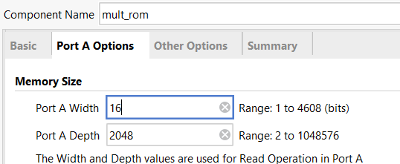
Block Rom

